Slide 1
Traversal of Anna Anthropy’s Queers in Love at the End of the World
Vee Kennedy, for Dr. Salter’s Fall ‘23 Playable Texts & Technology Course

Slide 2
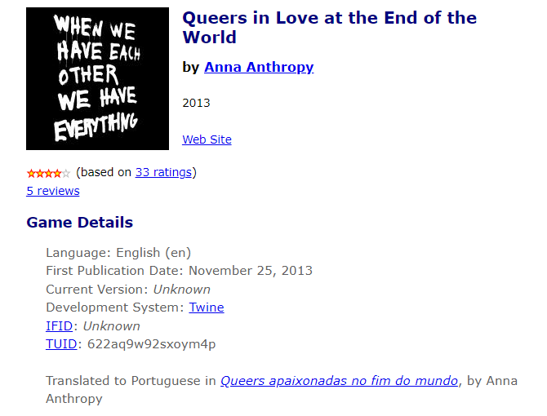
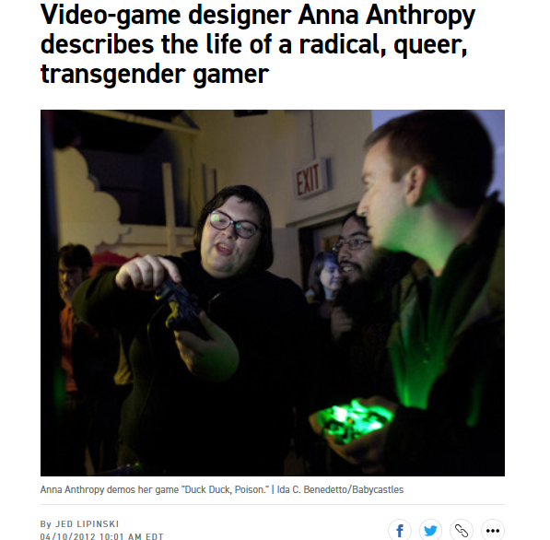

Slide 3
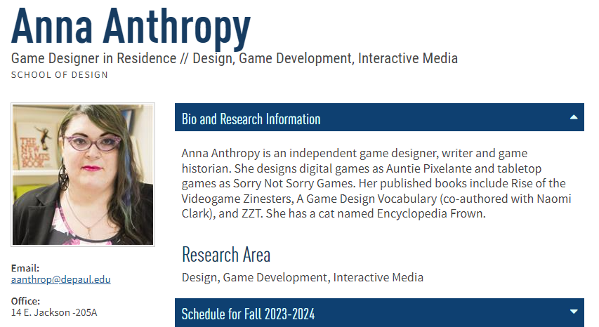

Slide 4
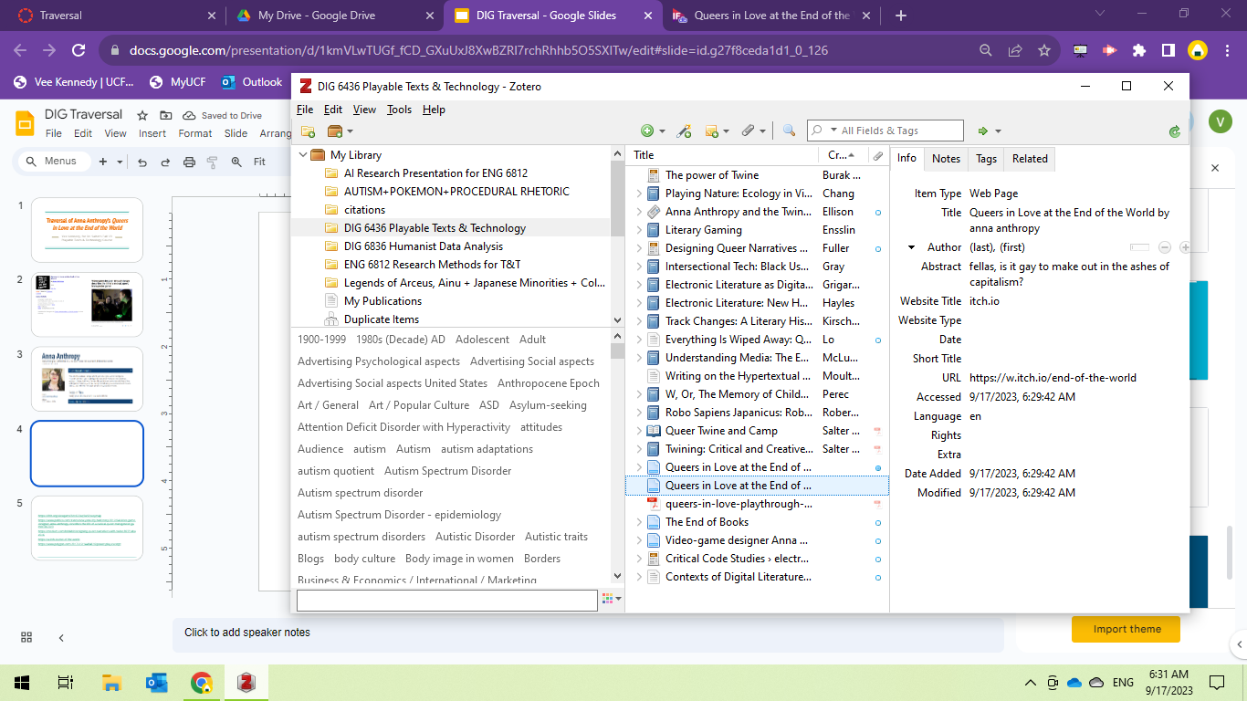

Slide 5
Works Referenced
Burak, Asi, and Laura Parker. “The Power of Twine.” Polygon, 2 Feb. 2017, https://www.polygon.com/2017/2/2/14484616/power-play-excerpt.
Burdick, Anne, et al. Digital_Humanities. MIT Press, 2012.
Ellison, Cara. “Anna Anthropy and the Twine Revolution.” The Guardian, 10 Apr. 2013. The Guardian, https://www.theguardian.com/technology/gamesblog/2013/apr/10/anna-anthropy-twine-revolution.
Fuller, Eden. “Designing Queer Narratives with Twine.” Brinkbit, 22 June 2017, https://medium.com/brinkbit/designing-queer-narratives-with-twine-865f1abae516.
Hayles, N. Katherine. Electronic Literature: New Horizons for the Literary. University of Notre Dame, 2008.
“Queers in Love at the End of the World by Anna Anthropy.” Itch.Io, https://w.itch.io/end-of-the-world. Accessed 17 Sept. 2023.
Salter, Anastasia, and Stuart Moulthrop. “Queer Twine and Camp.” Twining, Amherst College Press, 2021, pp. 205–30. JSTOR, https://www.jstor.org/stable/10.3998/mpub.12255695.10.
---. Twining: Critical and Creative Approaches to Hypertext Narratives. Amherst College Press, 2021.
Video-Game Designer Anna Anthropy Describes the Life of a Radical, Queer, Transgender Gamer - POLITICO. https://www.politico.com/states/new-york/city-hall/story/2012/04/video-game-designer-anna-anthropy-describes-the-life-of-a-radical-queer-transgender-gamer-067223. Accessed 11 Sept. 2023.

